Slide 1
CET311
Project Management
Lecture 04
Dr R L Warrender

Slide 2
Project Evaluation
Introduction
Why evaluate?
What is evaluated?
If we consider a commitment to a single project, then it will likely be judged on whether benefits exceed cost of implementation and operation of the new application
In other cases, projects have to viewed in terms of fulfilment of strategic objectives when combined with other projects.
Notes:
The second case is used to establish some form of internal infrastructure that in raw terms has no direct financial benefit, but could provide a platform for subsequent projects to do so.

Slide 3
Strategic Issues
Some typical strategic issues
Objectives
What will the project contribute to the organisations objectives

Slide 4
Strategic Issues
IS plan
Does the proposed project fit into the organisations Business plan?
How will the proposed project fit with existing systems?
How does it fit with proposed future developments?

Slide 5
Strategic Issues
Organisation structure
Management information system (MIS)
Personnel
Notes:
You need to consider what effect the new project would have on the existing Organisation structure, MIS and Personnel

Slide 6
Setting Out the Business Case
A typical business case document might contain:
Introduction and background to the proposal
The proposed project
The market
Organisational and operational infrastructure
The benefits
Outline implementation plan
Costs
The financial case
Risks
Management plan
Notes:
3. e.g. estimated demand for a new product, etc.
4. e.g. how the organisation will be effected in terms of personnel, plant layout, etc.
5. Most easily determined by putting a financial value on benefits but might also be strategic
Areas such as marketing, promotion or determination of outsourcing aspects, etc.

Slide 7
Technical Issues
Is it really understood what is required technically?
What functionality is required?
Notes:
Remember we are discussing new projects and it is crucial that we understand the full implication of meeting the demands of the project.
If in doubt, look into getting a feasibility study done.

Slide 8
Technical Issues
Do strategic issues place limitations on technical solutions
Cost constraints on technical solutions

Slide 9
Economic Issues
Cost-benefit analysis
Cash flow forecasting
Cost-benefit evaluation techniques
Risk analysis

Slide 10
Cost-Benefit Analysis
The comparison of estimated costs and benefits
The general question is
will income and other benefits exceed costs?
how do the various project options compare?

Slide 11
Cost-Benefit Analysis
Analysis is in two stages
Identify and estimate all costs and benefits
Convert costs and benefits into common units
Costs to be estimated
Development costs
Set-up costs
Operational costs

Slide 12
Cost-Benefit Analysis
Benefits to be estimated
Direct benefits
Assessable indirect benefits
Intangible benefits
Notes:
Direct benefits
Accessible indirect benefits
Take for example decaffeinated coffee, there is a substantial cost involved in removing caffeine from coffee. An accessible indirect benefit is the caffeine removed can be sold to companies specializing in caffeine drinks.
Intangible benefits
For example a much quieter plant or one that has less smells – intangible benefits include being a good neighbor.

Slide 13
Cash Flow Forecasting
Provides an estimate of the expenditure incurred and the income generated throughout the life of the product.
It is time related
It will provide an indication of when positive and negative cash flow will occur

Slide 14
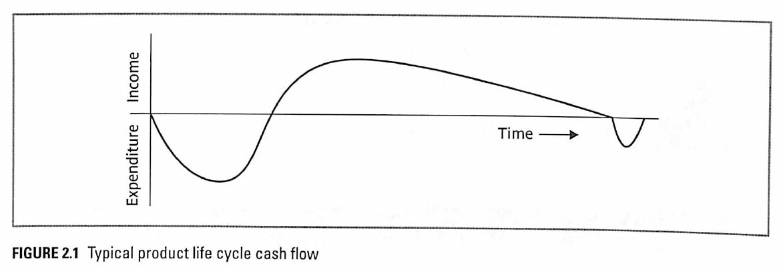
Cash Flow Forecasting
Notes:
All illustrations and figures taken for the module core text book.
Spend Money to make money
When estimating future cash flows, it is usual to ignore the effects of inflation. These tend to be uncertain. However if expenditure increases due to inflation, the generated income will likely increase proportionally.

Slide 15
Cash Flow Forecasting
It is not easy to get things right due to the number of uncertainties
The longer the whole life of the product the more uncertain is the forecast
The increase in alliance contracts and PPFI have increased the need for improving the accuracy of cash flow forecasting
Notes:
PPFI – Public / Private Finance Initiative

Slide 16
Cost-Benefit Evaluation Techniques
Five techniques will be explored:
Net profit
Payback period
Return on investment (ROI)
Net present value
Internal rate of return

Slide 17
Cost-Benefit Evaluation Techniques
Net Profit
NP = total income - total cost
A very simple technique
Does not consider time element
Of limited use when used in isolation

Slide 18
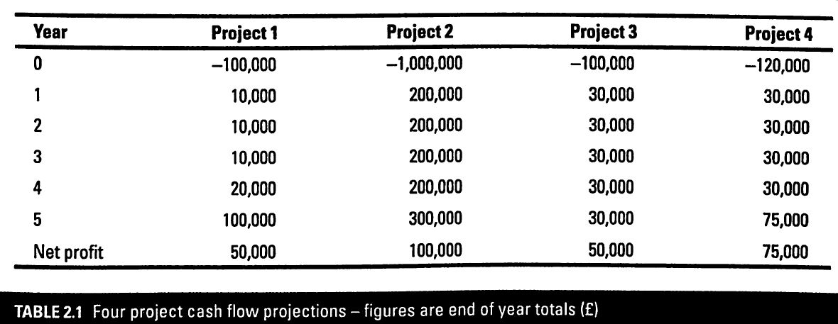
Cost-Benefit Evaluation Techniques
Net Profit
Notes:
Net profit is the difference between the total costs and the total income over the life of the project.
Here Project 2 shows the largest profit but requires the largest investment.
If we only had one million pounds to invest, it would seem logical to choose Projects 1, 3 and 4 to obtain a greater return
However although Projects 1 and 3 show the same Net Profit over five years, Project 1 has the bulk of the profit occurring late in the project life. Project 3 shows a steady return throughout its life.

Slide 19
Cost-Benefit Evaluation Techniques
Payback period
Time taken to break even
Projects with short payback periods are preferred nowadays
Does not consider income or expenditure after break even point is reached

Slide 20
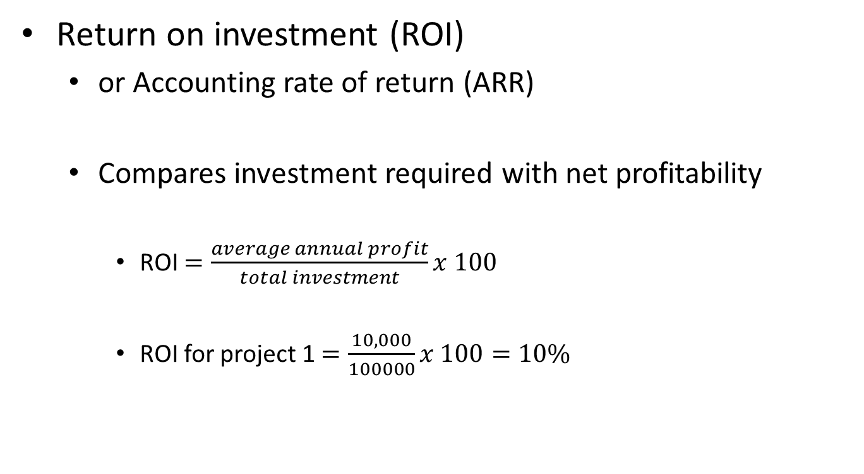
Cost-Benefit Evaluation Techniques
Return on investment (ROI)
or Accounting rate of return (ARR)
Compares investment required with net profitability
ROI $=\frac{average annual profit}{total investment}x 100$
ROI for project 1 $=\frac{10,000}{100000}x 100=10\%$

Slide 21

Cost-Benefit Evaluation Techniques
Net Present Value
NPV $=\frac{value in year t}{{(1+r)}^{t}}$

Slide 22
Cost-Benefit Evaluation Techniques
ROI is simple to calculate
this makes it a popular method
But, it has two major problems
It does not consider the time element
The ROI gets compared to bank interest rates
this is not a valid measure as timing and compounding of interest are no considered
This can lead to very misleading conclusions

Slide 23
Cost-Benefit Evaluation Techniques
Net present value (NPV)
considers profitability
takes account of the time element
NPV discounts future cash flows
to current money values
it does this using a percentage rate called the discount rate

Slide 24
Cost-Benefit Evaluation Techniques
NPV a simple example using inflation
£100 today = £100
£100 today will be worth less in a 12 months time if inflation is 5%
with 5% inflation £100 today = £95 in a years time
today’s present value of £100 gained in 12 months time would be worth only £95 if inflation is 5%
£100 gained in 5 years = £78 today if 5% inflation

Slide 25
Cost-Benefit Evaluation Techniques
NPV a simple example (cont.)
Another way of considering NPV is that it is the reverse of looking at the value of money from the past.
i.e. with 5% inflation to have the same purchase value of £100 5 years ago you would need to spend £128 today
NPV considers the value of money in the future with today as the baseline

Slide 26
Cost-Benefit Evaluation Techniques
The formula for net present values of future cash flows is
present value = value in year t / (1+r)^{t}
where r is the discount expressed as a decimal value
and t is the number of years in the future
A simpler method is to use discount tables
present value = value in year t x discount factor

Slide 27
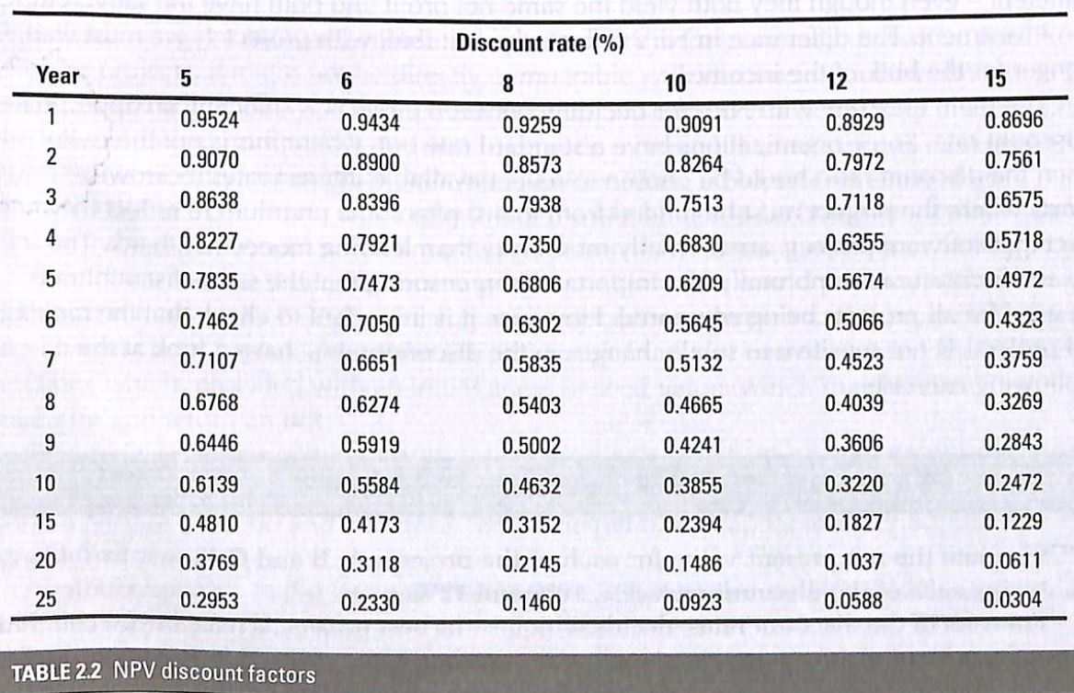
Typical NPV Discount Tables

Slide 28
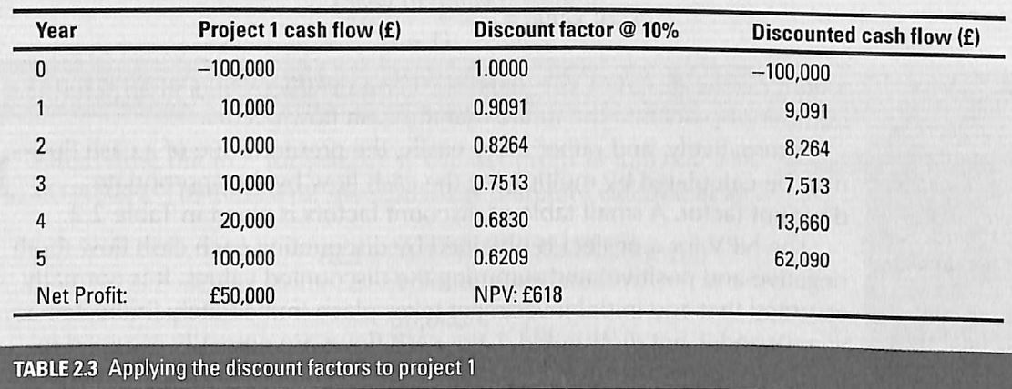
Cost-Benefit Evaluation Techniques

Slide 29
Cost-Benefit Evaluation Techniques
The NPV for all four projects.

Slide 30
Cost-Benefit Evaluation Techniques
Net present value disadvantages
may not be comparable to
other investments
cost of borrowing capital
a solution to this is to utilise Internal Rate of Return

Slide 31
Cost-Benefit Evaluation Techniques
Internal rate of return (IRR)
provides a profitability measure as a percentage return
this directly comparable to interest rate
IRR is used in conjunction with NPV

Slide 32
Cost-Benefit Evaluation Techniques
IRR is the discount rate when the NPV is 0
e.g. in project 1 the IRR is just over 10%
Calculation of IRR is trial and error when done by hand
IRR can also be estimated using a graphical method
Spreadsheet can often calculate IRR

Slide 33
Cost-Benefit Evaluation Techniques
Using the graphical method

Slide 34
Cost-Benefit Evaluation Techniques
NPV and IRR are not the complete answer
funding, future earning prediction, organisation context must all be taken into consideration

Slide 35
Risk Analysis
All projects involve some form of risk
Project evaluation has risks associated with it
Risk Identification
potential risks are identified, evaluated and ranked
Various analysis techniques available
e.g. Monte Carlo simulation
Notes:
What is Monte Carlo Simulation?
The Monte Carlo method was invented by scientists working on the atomic bomb in the 1940s, who named it for the city in Monaco famed for its casinos and games of chance. Its core idea is to use random samples of parameters or inputs to explore the behavior of a complex system or process. The scientists faced physics problems, such as models of neutron diffusion, that were too complex for an analytical solution -- so they had to be evaluated numerically. They had access to one of the earliest computers -- MANIAC -- but their models involved so many dimensions that exhaustive numerical evaluation was prohibitively slow. Monte Carlo simulation proved to be surprisingly effective at finding solutions to these problems. Since that time, Monte Carlo methods have been applied to an incredibly diverse range of problems in science, engineering, and finance -- and business applications in virtually every industry.

Slide 36
Concluding remarks
Project Evaluation
Strategic
Technical
Economic
Risk considerations

